Slide 1
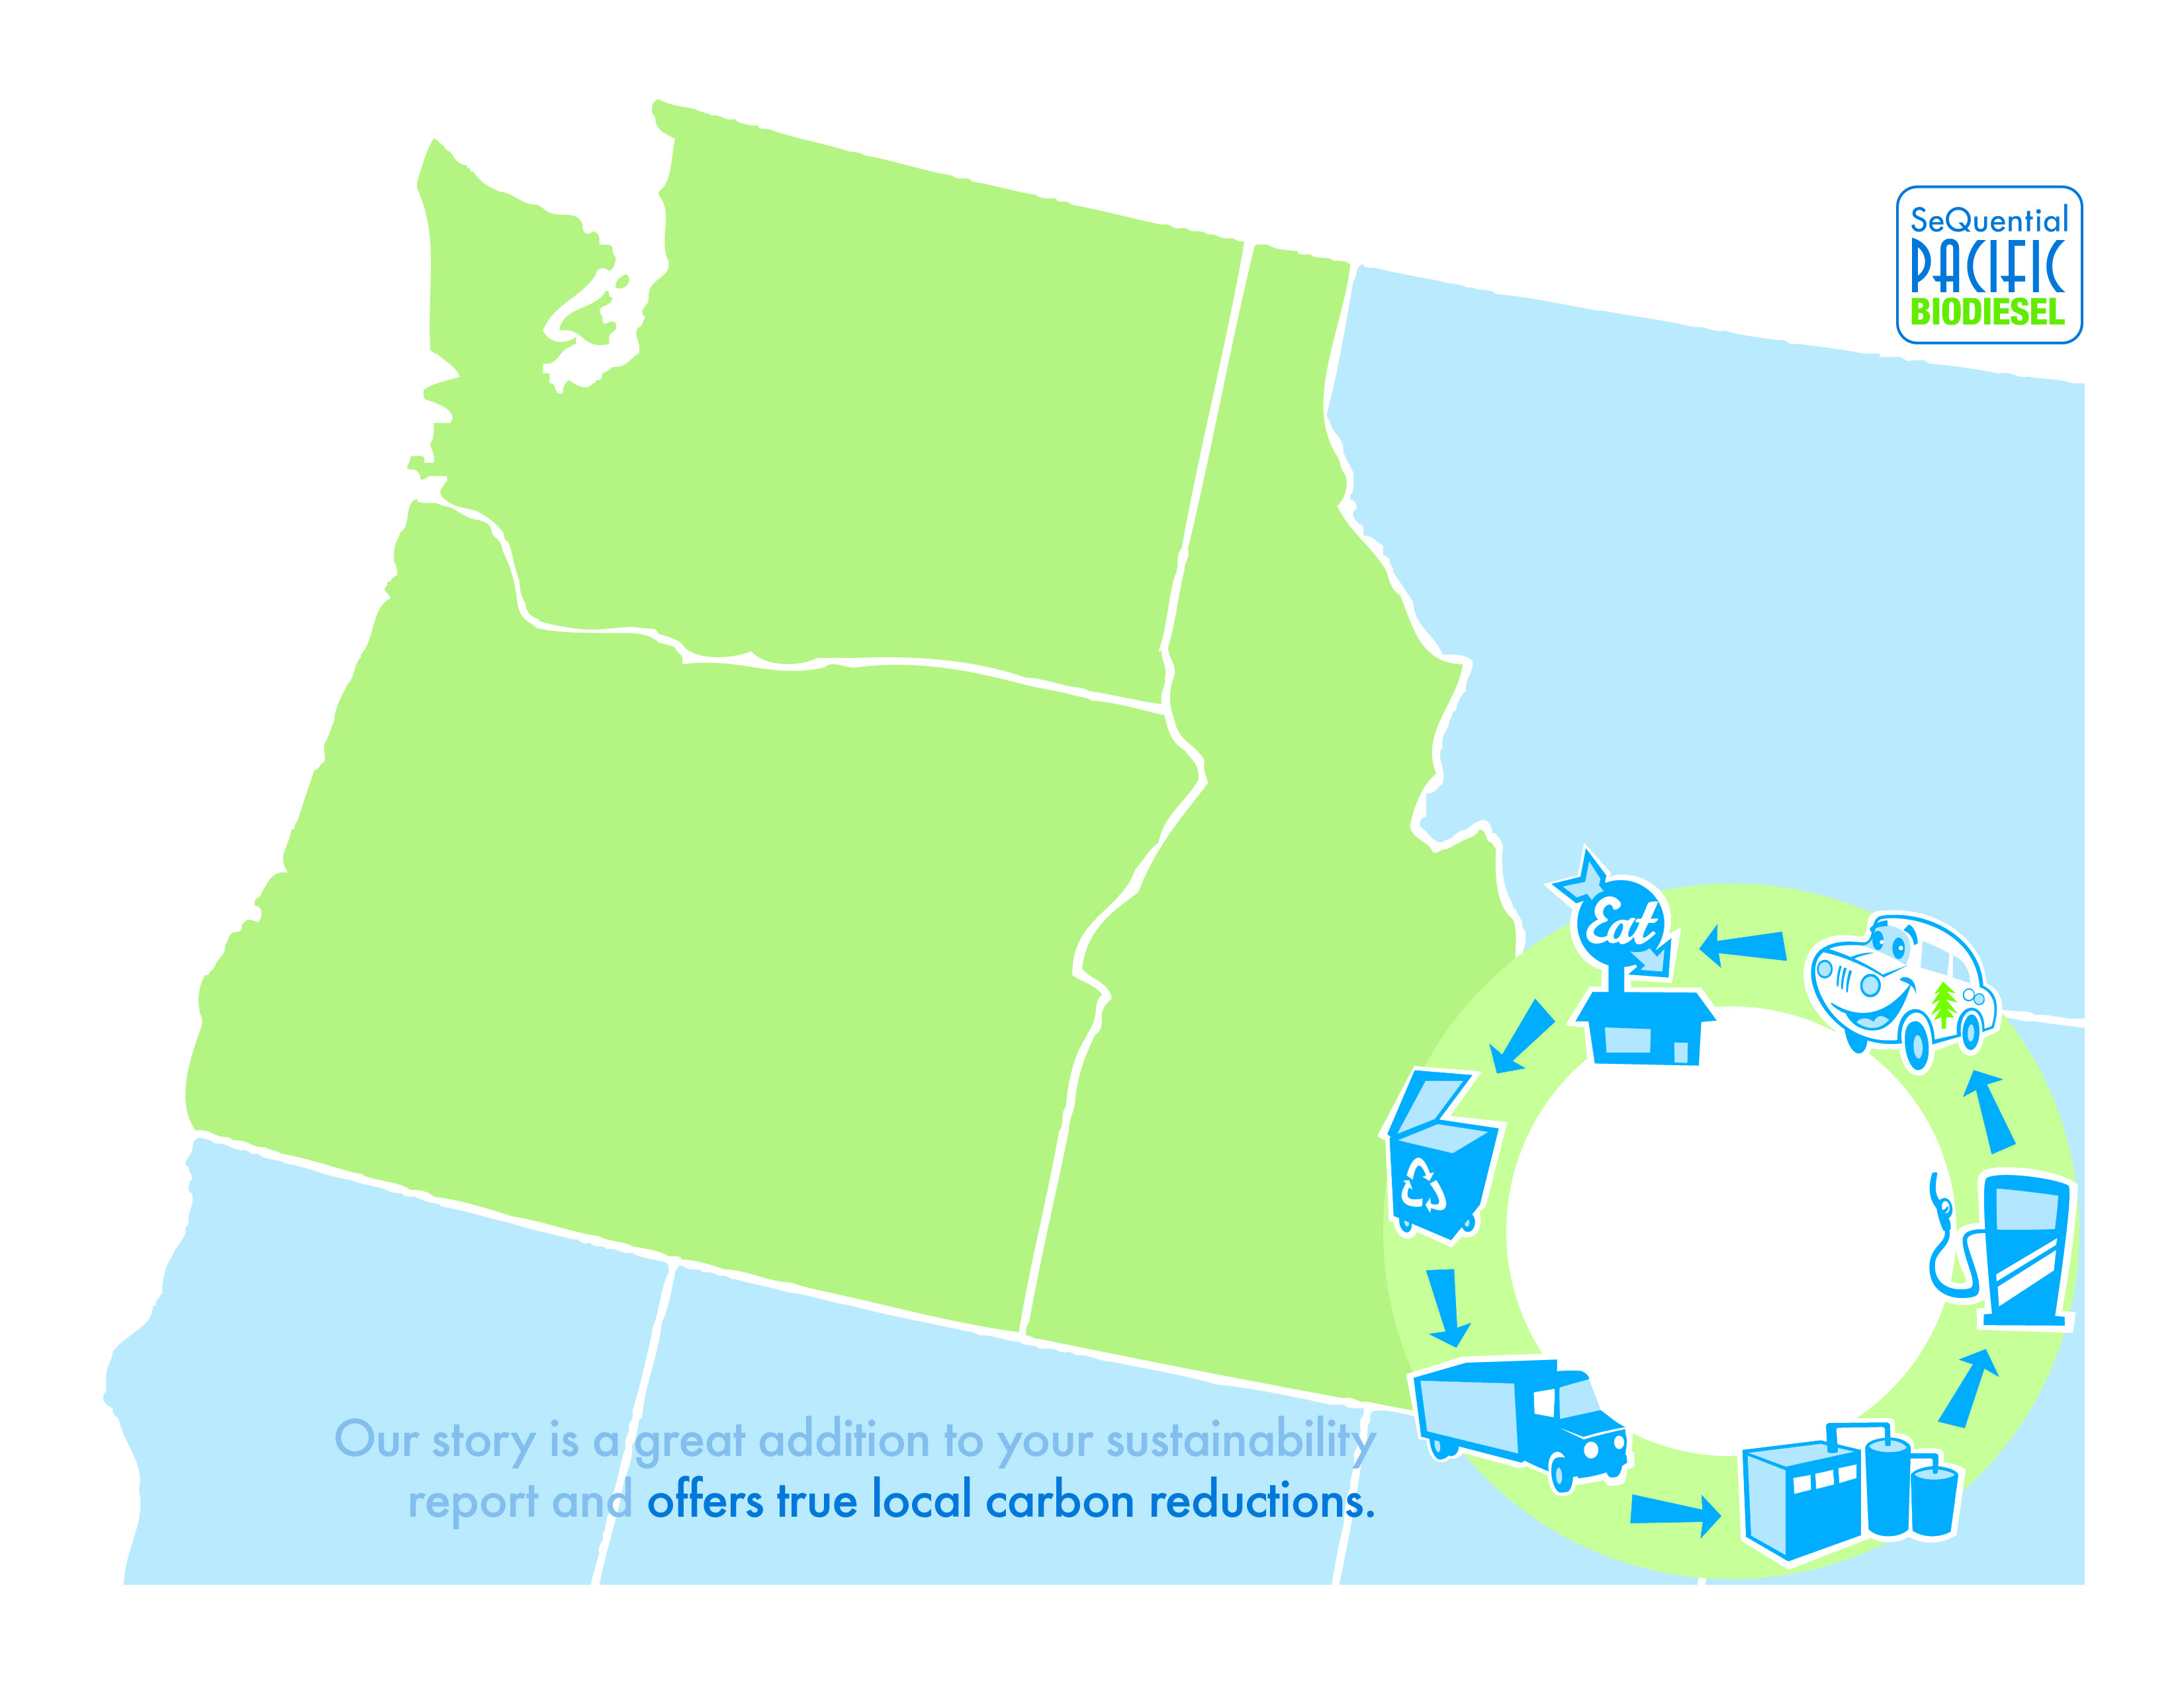
Carbon Reduction Report
DeSantis Landscape’s Carbon Reduction
Thank you for purchasing clean burning, locally made biodiesel from SeQuential Pacific Biodiesel. Together, we have accomplished the following this year:
Gallons of B20 Use: 98,823
Pounds of CO₂ saved: 371,614
What’s the impact?
By working with us to recycle your cooking oil into biodiesel, you are making a commitment to improve the environment and to invigorate the local economy.
The carbon reduction created by your oil is equivalent to:
Replacing 456 incandescent light bulbs with CFLs
Not driving for 399,584 miles
OR
Planting 126 trees
Additionally, working with SeQuential Pacific helps fuel the local economy by creating a local fuel source used to power fleets and vehicles throughout the region. Thank you for your continued partnership!

